Slide 1
To Retain or to Adapt? Generalizing Continual Learning
Lanzillotta et al. (2026)
Presented by Jaleel Radhu

Slide 2
Motivation
Real-time adaptation, not just retention. Should a continual learner always try to remember everything?
What should be the central objective of a Continual Learning agent? Retention or Adaptation?
Proposes a general framework for designing CL algorithms: Predictive CL.
What does our choice of CL objective assume about the future?
Training on all past data assumes the future will look like the past (average of the past).
Making this assumption explicit turns the choice of objective into a design space for new CL algorithms.

Slide 3





Continual Learning Setup
Environment
Action space A, observation space O, and a fixed rule 𝒫 for generating the next observation.
History
Everything the agent has seen up to step n. It grows by one pair every step.
Learn
The learning algorithm turns the history into a policy. This is where learning happens.
Predict
The current policy makes a prediction (action).
Observe
The environment produces new data. 𝒫 is fixed, but 𝒫_{n} changes over time because it depends on the growing history: this is the non-stationarity.
Evaluate
Error of the current policy on the next observation, before it has trained on it: the real-time error.

Slide 4
Continual Learning Objective
Given this setup what should our CL objective be?
Say we have a series of steps: step 1, step 2, . . . step k, . . . , N
To retain our training memory of all the task seen so far?
OR
To minimize our average error on the all the steps from 1 to N?

Slide 5
Continual Learning Objective
Given this setup what should our CL objective be?
Say we have a series of steps: step 1, step 2, . . . step k, . . . , N
To retain our training memory of all the task seen so far?
OR
To minimize our average error on the all the tasks from 1 to N?
Are 1 and 2 the same thing?

Slide 6
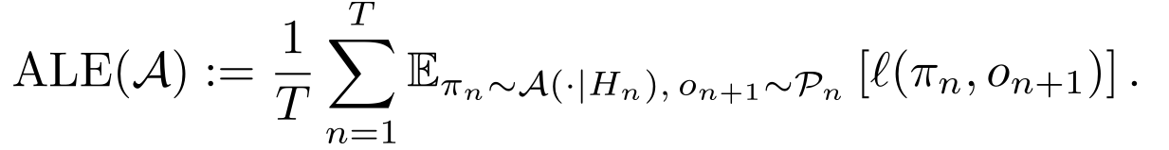
Continual Learning Objective
Average lifelong error (ALE):
Inf A
subject to computational constraints
We want to the average lifelong error of the agent to be minimized.

Slide 7
Continual Learning Objective
Average lifelong error (ALE):
Inf A
subject to computational constraints
We want to the average lifelong error of the agent to be minimized.
We need to find A, that is the learning algorithm or the algorithm which updates/trains the policy/model, which minimizes ALE.

Slide 8
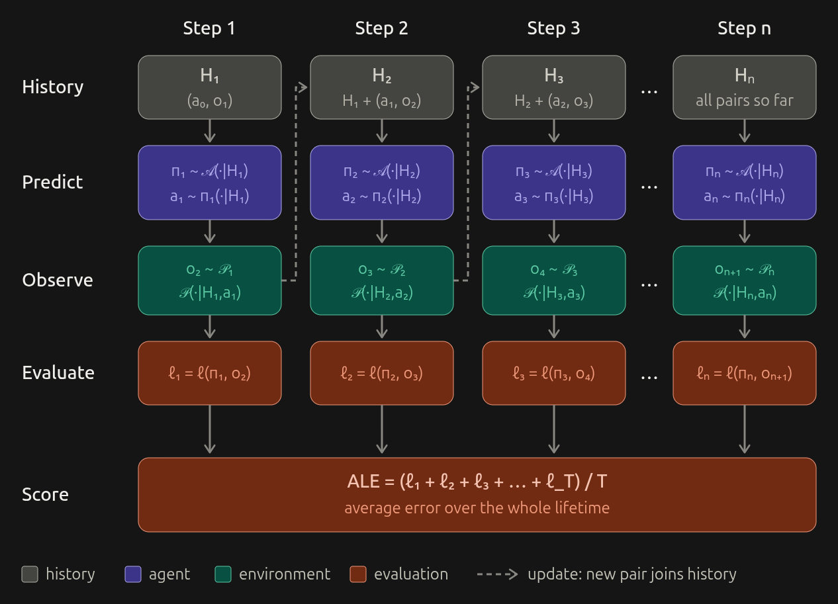
Continual learning objective

Slide 9

Task-Based Setup
Each task k is an interval S_{k} = [a_{k}, b_{k}] where data come from one fixed distribution Pᵏ. The data generating process P_n is locally stationary.
Task 1 · P¹
Step 1, 2, ..b₁
Task 2 · P²
Step a₂. . b₂
· · ·
Task k · Pᵏ
time →
a_{k}
b_{k}
N_{k} = |S_{k}| steps, each observation o_{n} ∼ Pᵏ
Average task error
Real-time error during task k,
with θ_{n} ∼ A(·|H_{n})
ALE(A) = Σ_{k} (N_{k} / T) · ALE_{k}(A)
Lifelong error is a weighted average of task errors: a task counts in proportion to how long it lasts.

Slide 10
The learning Algorithm
sample
U
n → ∞
D_{n}
ξ_{n}
Q_{n}
Q∞
Sampling distribution
Data batch
Parameter distribution
Stationary limit
Picks the training data; replay mixes in past tasks (gray).
The examples drawn from D_{n} for one update step.
Spread of θ_{n} across random seeds at step n.
Where Q_{n} settles if training stays on one task.
One training step: θ_{n+1} = U(θ_{n}, ξ_{n}), ξ_{n} ∼ D_{n} (e.g. one SGD step)

Slide 11
The learning Algorithm
sample
U
n → ∞
D_{n}
ξ_{n}
Q_{n}
Q∞
Sampling distribution
Data batch
Parameter distribution
Stationary limit
Picks the training data; replay mixes in past tasks (gray).
The examples drawn from D_{n} for one update step.
Spread of θ_{n} across random seeds at step n.
Where Q_{n} settles if training stays on one task.
One training step: θ_{n+1} = U(θ_{n}, ξ_{n}), ξ_{n} ∼ D_{n} (e.g. one SGD step)
Q₀: distribution of the starting parameters θ₀ (the random initialisation)
Q₁: distribution of θ₁, after one update step on a random batch ξ₀

Slide 12
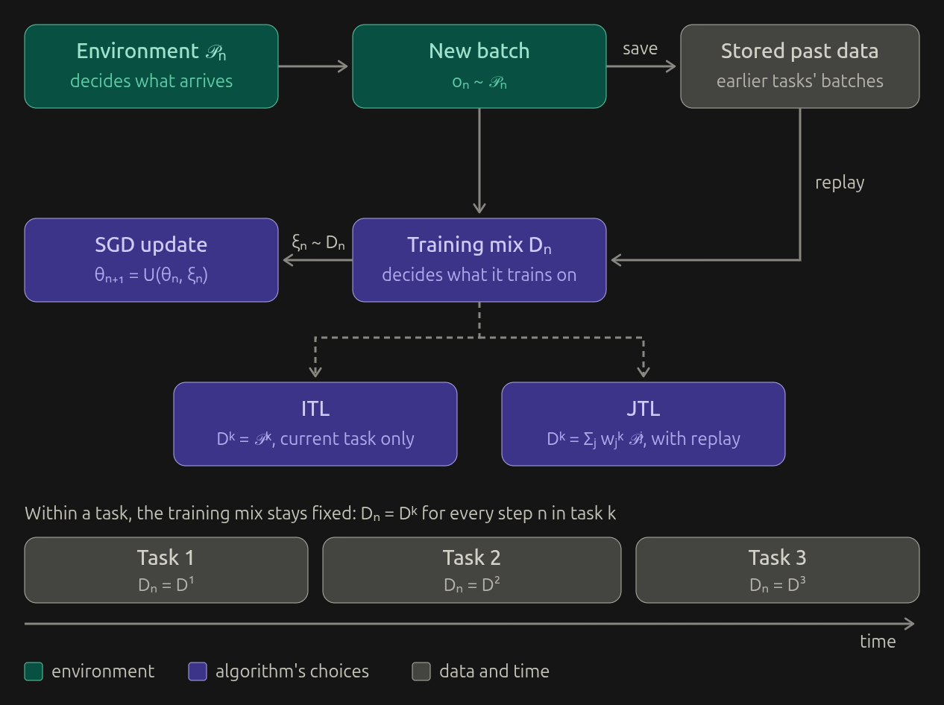
The learning Algorithm
P_{n} vs D_{n}: the environment’s P_{n} decides what data arrives; the algorithm’s D_{n} decides what it trains on.
Within a task, D_{n} = D_{k}.and P_{n} = P_{k}
(Note: n is the time step number and k is the task number.

Slide 13
How to choose D_{k}?
Only have control over our choice of D_{k}, that is what distribution/data we choose to train our model on after each time step withing a Task k, AND
U the learning algorithm. (e.g SGD, Adam, etc)

Slide 14
How to choose D_{k}?
One option is we store all data seen in all the tasks seen so far and train on all of it.
This is one extreme

Slide 15
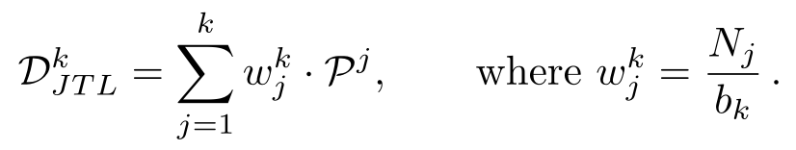
How to choose D_{k}?
One option is we store all data seen in all the tasks seen so far and train on all of it.
This is one extreme
This gives us the joint task learning (JTL) algorithm where:
W^{k}_{j} is just the fraction of task j’s duration in all the tasks from 1 to k.
Just to recall: N_{j} = Duration of Task j; b_{k}= is the final time step of task k

Slide 16
How to choose D_{k}?
The other option is we forget everything seen and trained on so far. And start with a fresh model before each task k.
This is the other extreme

Slide 17

How to choose D_{k}?
The other option is we forget everything seen and trained on so far. And start with a fresh model before each task k.
This is the other extreme
This gives us the Independent task learning (ITL) algorithm:

Slide 18
JTL vs ITL
We get two extremes of CL algorithms in the current setup

Slide 19
JTL vs ITL
Which is better: JTL or ITL?
Put another way: does memory help?

Slide 20

JTL vs ITL
Which is better: JTL or ITL?
Put another way: does memory help?
To answer this, the paper defines Transfer Efficiency (TE):
Gain of JTL over ITL on task k (ALE^{k} = average error on task k)

Slide 21
JTL vs ITL
Which is better: JTL or ITL?
Put another way: does memory help?
To answer this, the paper defines Transfer Efficiency (TE):
Gain of JTL over ITL on task k (ALE^{k} = average error on task k)
TE > 0: memory helps. Memory of past tasks lower the error on task k.

Slide 22
JTL vs ITL
Which is better: JTL or ITL?
Put another way: does memory help?
To answer this, the paper defines Transfer Efficiency (TE):
Gain of JTL over ITL on task k (ALE^{k} = average error on task k)
TE < 0: memory hurts. Past tasks raise the error on task k.

Slide 23
Instability
Why can TE be positive or negative?
Follow the loss on task k as each agent trains:
JTL starts lower (warm start), but can settle higher.
ITL starts from scratch, but settles at task k’s own best.
loss on task k
warm start: JTL begins lower
ITL: extra loss while learning from scratch
JTL
final gap
ITL
Q_{n}
Q∞
training steps

Slide 24


Instability
Where does each agent end up?
Compare their losses once training has converged:
Instability (I): JTL’s extra loss at convergence
I > 0: past tasks leave JTL at a worse final solution
L^{k}: expected loss on task k;
Q∞: parameter distribution after training converges.
Assumption: The training will converge.

Slide 25
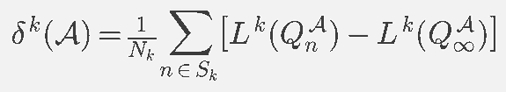
Transient Error
How fast does each agent get there?
Measure the loss it carries above its final level:
Transient Error (δ): average extra loss (over the stationary loss ) while learning
Small δ: the agent converges quickly. A warm start lowers δ.

Slide 26
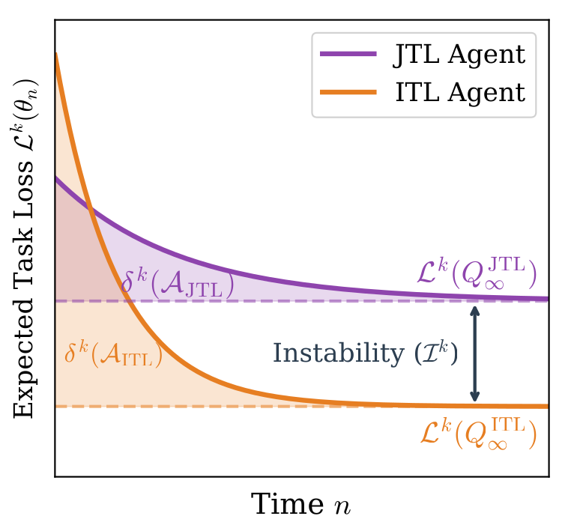
Transient Error
How fast does each agent get there?
Measure the loss it carries above its final level:
Small δ: the agent converges quickly. A warm start lowers δ.
Figure is from the paper

Slide 27

Instability and Transient Error
Does memory help? Weigh both effects:
TE splits exactly into the two terms:
−I: memory can worsen the final solution (stationary gap).
The gap you get even after getting best possible model in both ITL and JTL process
δ gap: memory can speed up learning (learning-speed gap) [

Slide 28
Instability and Transient Error
Does memory help? Weigh both effects:
TE splits exactly into the two terms:
−I: memory can worsen the final solution (stationary gap).
The gap you get even after getting best possible model in both ITL and JTL process
δ gap: memory can speed up learning (learning-speed gap) [increasing n illustration]

Slide 29
The Critical Task Duration
What happens as tasks get longer?
Track both terms of TE as the task duration N grows:
Instability Ī does not depend on N: it stays fixed.
The learning-speed gap shrinks as N grows.
learning-speed gap: shrinks as N grows
?
Ī: fixed
task duration N
Assumption: The training will converge.

Slide 30
The Critical Task Duration
What happens as tasks get longer?
Track both terms of TE as the task duration N grows:
Past the crossing, ITL catches up and TE turns negative.
That crossing is the Critical Task Duration, N∞_{max}.
learning-speed gap: shrinks as N grows
TE < 0: memory hurts
Ī: fixed
TE > 0: memory helps
task duration N
N∞_{max}
Assumption: The training will converge.

Slide 31
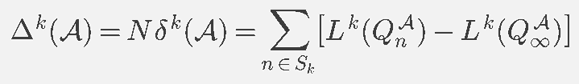
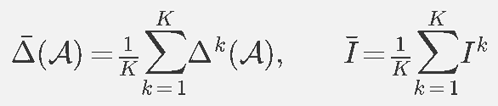
Critical Task Duration: New Terms
Setup: K tasks, each lasting N steps
Cumulative transient error: total extra loss over task k
Average both quantities over the K tasks:
Sublinear: f(N) ∈ o(N) means f(N) / N → 0 as N → ∞
e.g. √N and log N are sublinear; N / 2 is not

Slide 32

Critical Task Duration: Assumptions
Convergence: the cumulative transient error Δ is sublinear, Δ ∈ o(N)
Positive instability: average Instability Ī > 0
Then transfer becomes harmful (TE < 0) beyond:
Δ ∈ o(N): the extra loss per step, Δ / N, dies out
Larger Ī (a less predictable world): shorter window for transfer

Slide 33
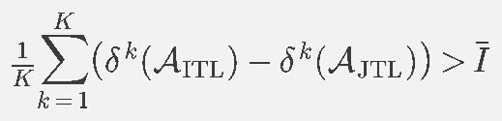
Critical Task Duration: Proof (1/2)
Step 1: start from the definition of TE and split it (Lemma 5):
Step 2: average over the K tasks; TE > 0 exactly when
Left: average learning-speed gap. Right: average Instability.

Slide 34

Critical Task Duration: Proof (2/2)
Step 3: substitute δ^{k} = Δ^{k} / N into Step 2:
Step 4: Ī is fixed, but the left side → 0 as Δ ∈ o(N); they meet at
So TE < 0 once N > N∞_{max}: ITL ends up ahead

Slide 35
Empirical Validation: Benchmarks
Three benchmarks, chosen to span a range of Instabilities:
CLEAR
MD5
MT10
Image classification
Image classification
Reinforcement learning
10 image classes evolving smoothly over 2004–2014
5 unrelated public datasets in sequence, with sharp semantic jumps
10 Meta-World robot-manipulation tasks, known for task interference
Smooth drift: low Instability
Sharp shifts: high Instability
Interfering tasks: high Instability

Slide 36
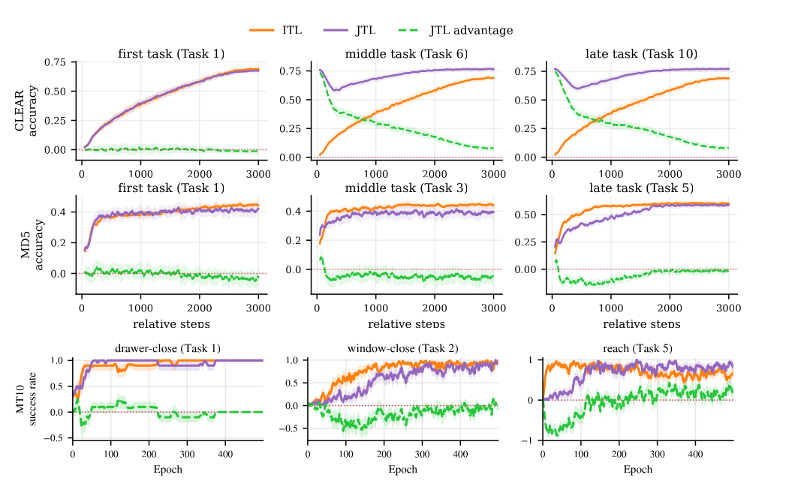
Empirical Validation: Setup
Same task duration N for all tasks
Hyperparameters tuned per algorithm for the lowest ALE
ITL and JTL run with matched compute
Score: Average Lifelong Accuracy or Success rate (ALA / ALS)
TE is signed so that TE > 0 means JTL beats ITL
Figure is from the paper

Slide 37
Empirical Validation: Setup
Same task duration N for all tasks
Hyperparameters tuned per algorithm for the lowest ALE
ITL and JTL run with matched compute
Score: Average Lifelong Accuracy or Success rate (ALA / ALS)
TE is signed so that TE > 0 means JTL beats ITL
Results in the wild (higher is better; MT10 reports success rate)
Benchmark | N | ITL | JTL | TE
CLEAR | 3,000 | 0.465 | 0.681 | +0.216
MD5 | 3,000 | 0.470 | 0.430 | −0.040
MT10 | 500 | 0.514 | 0.274 | −0.240

Slide 38
Empirical Validation: Predictions
Both predictions follow from the TE decomposition:
P1 : Instability shifts TE by a constant, whatever N is
TE then decays toward that constant at a 1/N rate

Slide 39
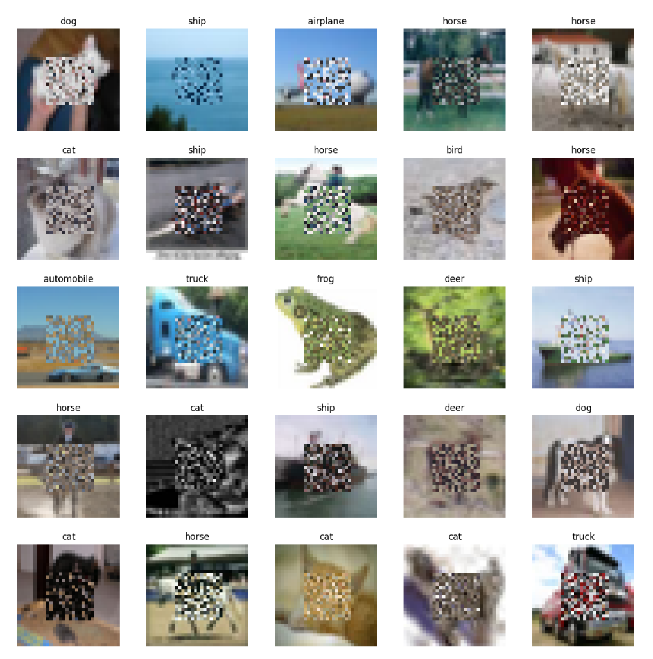
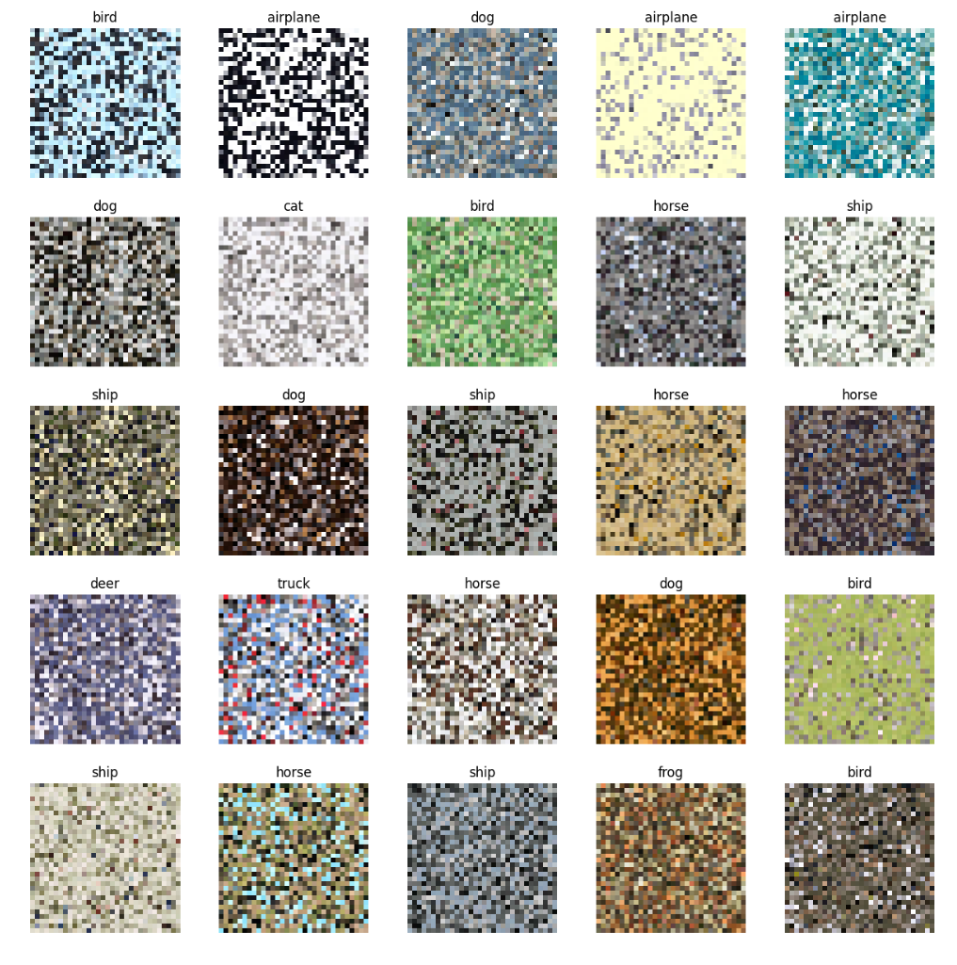
Testing P1: Controlling Instability on CIFAR-10
Permuted (PC-16/24/32): pixels shuffled inside a centred box
Shuffled (SC-10/30/50): 10/30/50% of labels reassigned
Expect Shuffled to be more unstable: one image, conflicting labels
Figure is from the paper
PC-16: 16×16 box (Fig. 18)
PC-32: 32×32 box (Fig. 19)

Slide 40
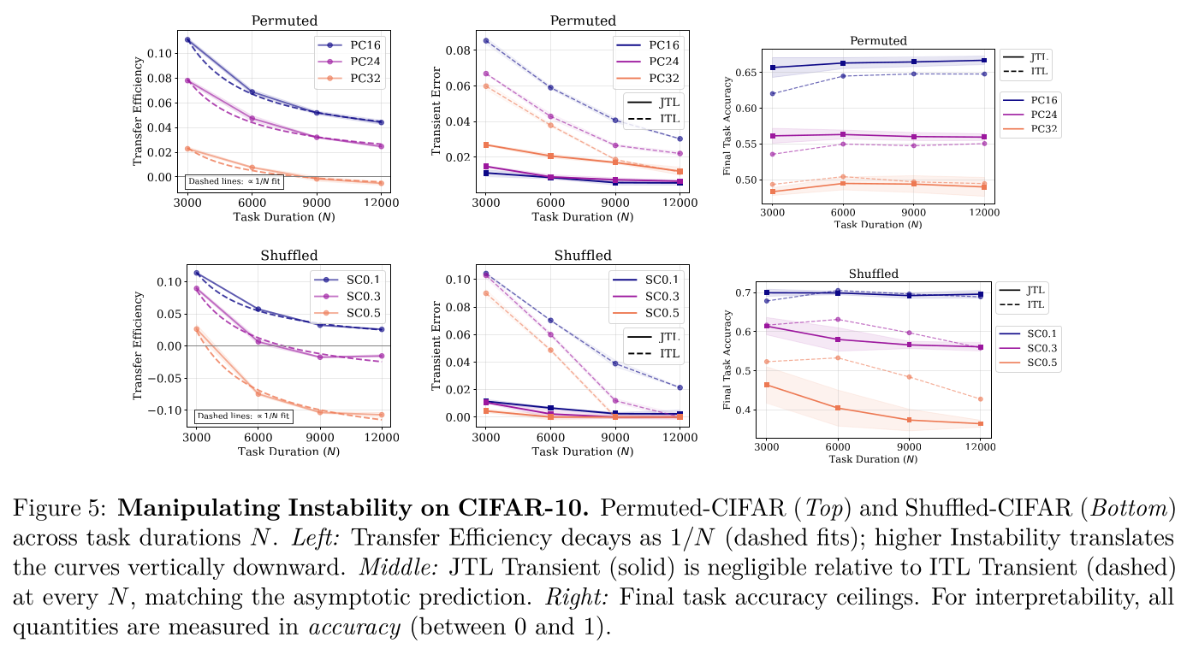
Testing P1: Results
Figure is from the paper
Left: stronger shifts move the TE curves down, and TE decays as 1/N (dashed fits)
Middle: JTL transient error ≈ 0, so TE is driven by Instability and ITL’s transient

Slide 41
Empirical Validation: Predictions
Both predictions follow from the TE decomposition:
P2 f: if Ī > 0, a longer N turns TE from positive to negative
Once both agents converge, TE is dominated by −I

Slide 42
Testing P2: Critical Task Duration on CLEAR
Sweep N ∈ {3,000, 6,000, 9,000, 12,000} steps per task on CLEAR
N | ALA ITL | ALA JTL | TE | δ ITL | δ JTL | I conv
3,000 | 0.465 | 0.681 | +0.216 | 0.227 | 0.079 | −0.066
6,000 | 0.562 | 0.713 | +0.151 | 0.195 | 0.063 | −0.011
9,000 | 0.610 | 0.720 | +0.110 | 0.166 | 0.057 | −0.003
12,000 | 0.641 | 0.732 | +0.100 | 0.148 | 0.054 | −0.0006
TE falls from +0.216 to +0.10 as N grows: ITL converges further, shrinking δ ITL and I conv
CLEAR has Ī ≈ 0, so TE decays toward 0 instead of crossing it
MD5 and MT10: TE is already negative at the smallest N tested
I conv: finite-time estimate of Instability. Accuracy in [0, 1]; ± over seeds omitted. Source: Table 2 of the paper.

Slide 43
Predictive CL: Is There an Optimal Objective?
Neither JTL nor ITL minimizes ALE in every environment
Unpredictable (adversarial) world: no first-order method beats online gradient descent on the current task
Partly predictable world: an algorithm can do better (Rakhlin & Sridharan, 2013)
If the next distribution were known, we would sample training data from it and minimize the next-step loss directly

Slide 44
Every Objective Encodes a Model of the Future
Choosing what to train on is an implicit bet on what comes next:
JTL
ITL
Predictive CL
Future = past
No usable structure
Explicit future model
The world is ergodic: the classical i.i.d. premise of empirical risk minimization. Replay and anti-forgetting methods approximate it.
Nothing can be reliably extrapolated, so online gradient descent on the current task is minimax-optimal.
Make the model of the future a design choice instead of leaving it implicit in the objective.

Slide 45
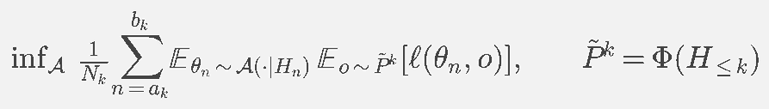
Predictive CL (Definition 9)
A prediction mapping Φ turns the history into a predicted distribution for the current task
JTL: Φ predicts a weighted mix of all past tasks
ITL: Φ predicts the current task only
JTL and ITL are special cases, so the best Φ for an environment matches or beats both

Slide 46
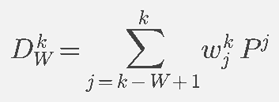
Proof of Concept: the Window Algorithm
Predict the future from the last W tasks and train on a mix of them:
time →
Task 1
Task 2
· · ·
Task k−W+1
· · ·
Task k−1
Task k
Older tasks are not trained on
Window: the last W tasks, mixed with weights w

Slide 47
Window Size Interpolates Between ITL and JTL
The Window agent never resets its parameters, like JTL
W = 1
1 < W < ∞
W → ∞
ITL
Window
JTL
Train on the current task only, starting from the initialized parameters
Train on recent W tasks only
Train on every past task: an infinite window

Slide 48
Better Future Models
The Window encodes one prior: recent tasks predict the next, summarized by a single number W. The same framework allows richer choices of Φ:
Generative model
Selective replay
Produces samples that resemble future tasks
A learned replay distribution that does not sample the past uniformly

Slide 49
Thank You !

